Slide 1
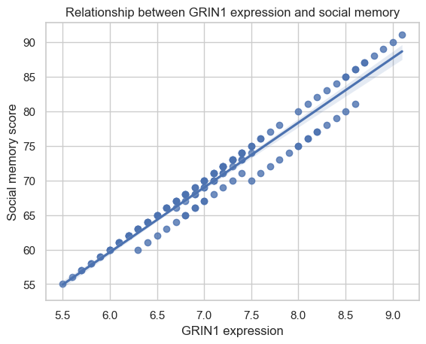
Does GRIN1 expression correlate with social memory
Pearson correlation analysis revealed a very strong positive relationship
between GRIN1 expression and social memory performance (r = 0.978, p < 0.001),
indicating that mice with higher GRIN1 expression tend to show better social
memory scores.
Given the role of GRIN1 in NMDA receptor function and synaptic plasticity, higher GRIN1
expression may contribute to neural mechanisms that support social cognitive
performance.

